Slide 1
Developing a new assessment
CASE STUDY: Poster session assignment in MG5003 Engineering Communication within the BEngTech

Slide 2
Contents
MG5003 overview
Starting point
LO3 + industry
Poster session criteria
Findings + outcomes

Slide 3
MG5003 Overview
Aim/Purpose
To enable students to communicate effectively in their professional environment.
Learning Outcomes
On successful completion of this course, the student will be able to:
Write effective reports.
Design relevant documentation.
Make effective presentations.
Give and receive clear instructions.
Research and reference to support field of study.
Assessment type | Weighting
Report | 40%
Presentation | 40%
Written instructions | 20%

Slide 4
Starting point
I taught the course for the first time in 2017
I was handed a developed course and set of assessments from the previous lecturer
LO3 was assessed through a paired debate (25%) and contributions to class discussions (13%)

Slide 5
LO3 + industry
I decided to make significant changes to the course in 2018
I considered the types of presentations I’d seen in industry
Short project update presentations
Seminar length and style presentations
Conference poster sessions
Community drop in sessions
Best student poster awards at forum
Two new assessments added to reflect industry presentation environments
Informative presentation
Poster session

Slide 6
LO3 assessments by year
2017 | 2018 | 2019 Maternity Leave | 2020
Debate (25%) | Debate (10%) | Debate (10%) | Presentation (25%)
Class discussions (13%) | Presentation (15%) | Presentation (15%) | Poster session (15%)
 | Poster session (10%) | Poster session (10%)
38% | 35% + 5% borrowed from a research assignment | 35% + 5% borrowed from a research assignment | 40%

Slide 7
Poster Session criteria
New assessment I hadn’t seen run at OP, or other institutes, before
Modelled after a conference poster session
Developed skills to help students meet industry needs
Scaffolded students to final year posters

Slide 8
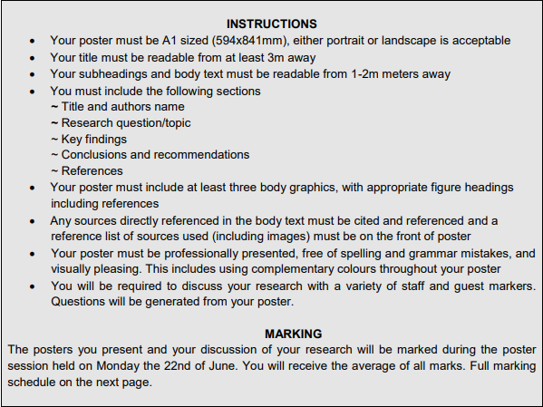
Student Instructions
Linked to a single research topic running through the course
Develops the ability to carry out research and communicate findings in different ways
OP covers printing costs if submitted my certain date

Slide 9
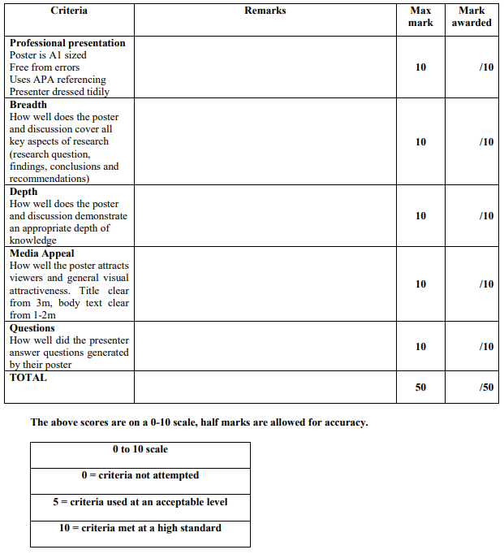
Marking schedule
Sent to invited markers before event
Students receive average of all marks

Slide 10
Findings and outcomes
To run a smooth poster session you need…
At least four markers in the room at a time
Clip boards
Multiple printed marking schedules
Post it flags
Appropriately sized space
Drinks and Nibbles

Slide 11
Findings and outcomes
Anecdotal student feedback on poster session
Surprisingly enjoyable
Confident that they can explain their ideas to a range of people
Enjoyed getting to have more detailed one on one conversations about their work
Different presentation/discussion style to a seminar style presentation
Little sandwiches made the event feel formal and relaxed at the same time
Third year posters have improved this year
Monitor, staff, and guests at Engineering Showcase impressed by quality of third year posters
Hopeful that OP student posters will win awards at NZBED forum in 2021

