Slide 1
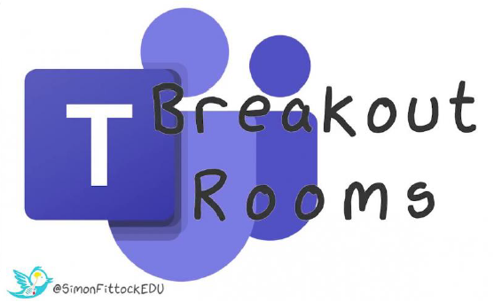
MS Teams for On-line Delivery
A report on assessing the effectiveness of MS Teams and specifically the use of Breakout Rooms to carry out group activities in an on-line delivery situation
David Bettis & Dave Maslin

Slide 2
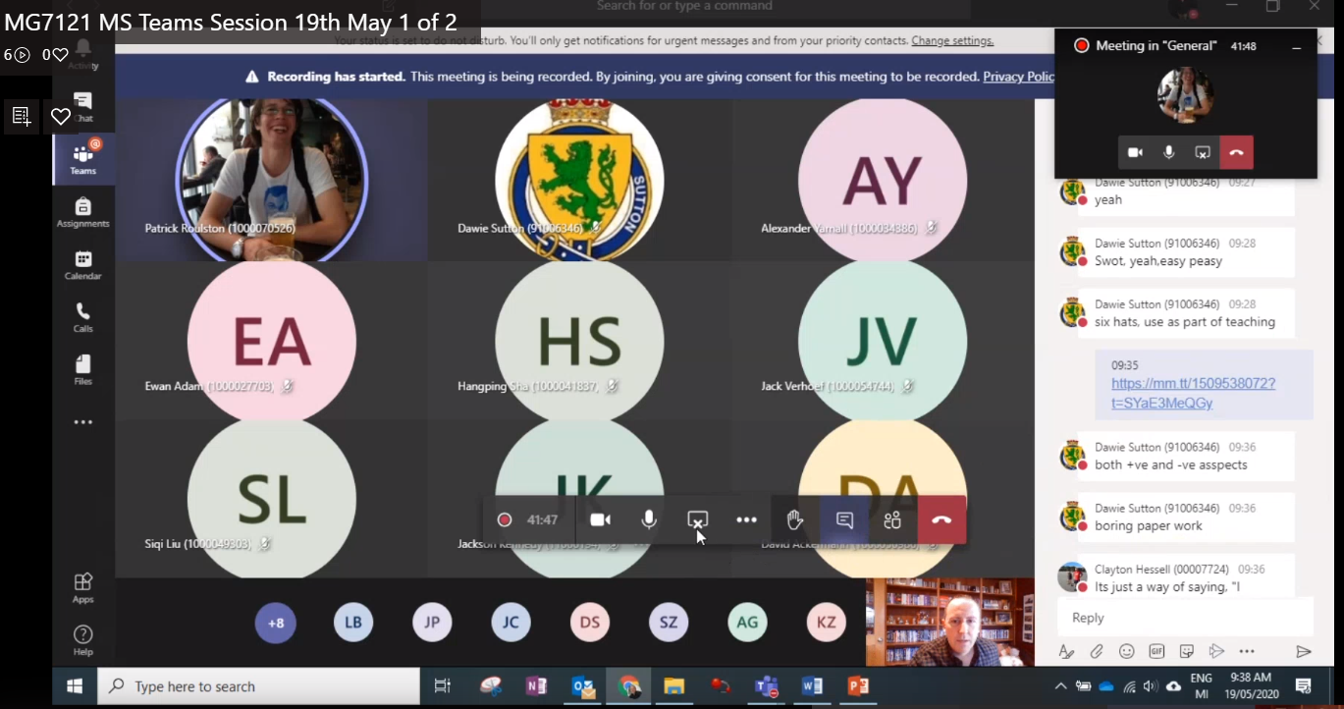
Introduction
Some common problems with on-line learning include:
Technical difficulties e.g. hardware, broadband connection & bandwidth
Computer literacy, including troubleshooting basic computer problems e.g. audio or camera settings
Lack of interaction, learners may be content with not contributing to class discussions
Lack of opportunities to carry out group activities and provide support and feedback to learners

Slide 3
What is a Breakout Room?
A Breakout Room is a feature that allows you to group learners into smaller cohorts.
When in a Breakout Room participants will leave the large group setting and only see the other people in their group.
The general purpose is to allow people more freedom to collaborate with one another in a smaller, less intimidating setting.
Generally before participants leave the main group, a task, activity or discussion point is assigned to each group for them to work through.

Slide 4
Why use Breakout Rooms?
The purpose of Breakout Rooms is to solve some of the issues with on-line delivery, such as:
knowing when to speak, e.g. same learners leading the conversation
feeling too uncomfortable to speak in a large session.
Breakout Rooms are a great way of creating discussions across disciplines (e.g. Civil, Mechanical & Electrical Engineering students)
Breakout Rooms are also excellent for focusing on discipline specific tasks (e.g. investigating a specific standard relevant to a certain discipline)
They are engaging and a good way to keep students focused on a specific task or activity.
A good way to help develop student relationships and teamwork.
Great to help integrate international students e.g. Dalian, into the class

Slide 5
Example Breakout Room Activity
BEngTech MG7121 Professional Engineering Practice session on NZ Contract Law in an Engineering context.
Activity to consider a case study of a court case, a contract dispute between Concrete Structures Ltd vs NZ Windfarms Ltd (2014).
Each group were issued a specific part of the contract dispute to look at. There were four different claims, each relating to various delays or issues with constructions of the wind tower bases.
The aim for each group was to prepare a short presentation, detailing the nature of the claim, the outcome of the judge’s decision relating to that claim, and lastly, to comment on the reasoning for the decision to the contract standards NZS3910:2013.
I allowed 30 minutes for the activity, after this time, all groups would meet back in the main MS Teams session and present their findings.
During the activity, I would visit each Breakout Room to check they fully understood the activity and provide any support they needed to complete the task.

Slide 6
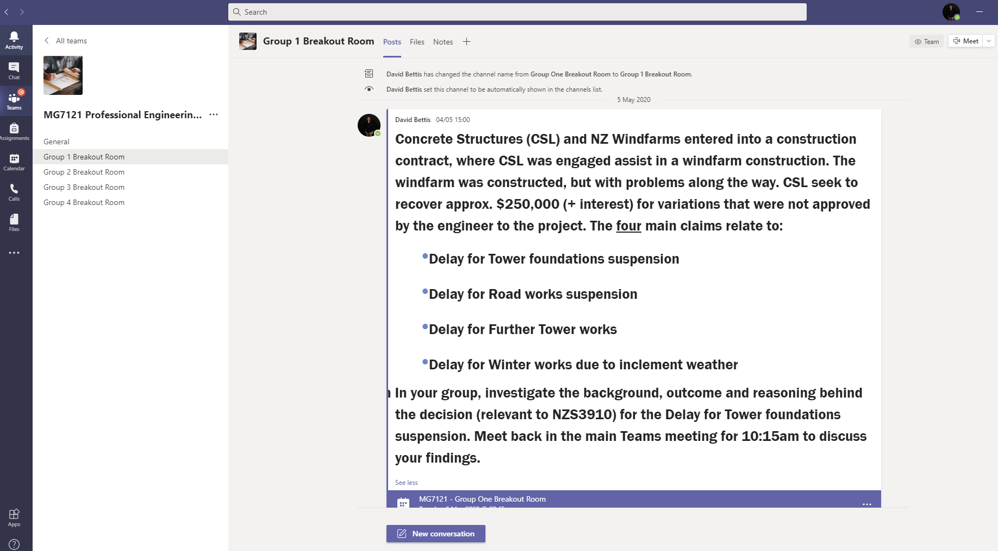
Example Breakout Room Activity
Channels can now be made private in MS Teams

Slide 7
Learner Feedback Survey Results
With the help of OP Research team, a student survey was completed to help gauge the effectiveness of the MS Teams Breakout Room sessions.
Based around four main questions to assess effectiveness (from five rankings of ‘Not effective at all’ to ‘Extremely effective’.
Follow up prompts to ask the learner what was or wasn’t effective.
Q1. How would you rate the use of MS Teams Breakout Rooms for Group Activities?
‘Breaking the main group into smaller
groups with individual tasks eases
communication’
‘They allowed you to get in group
discussions that you would normally
be able to do in a classroom environment

Slide 8
Learner Feedback Survey Results
Q2. How well did your group stay on-track with the activity during the Breakout Room session?
Q3. How well did your lecturer support your group in helping you achieve the goals of the Breakout Room activity?
‘Sending the materials and tasks
before the class so I have time to
prepare’
‘Communicated well with each
group to check progress and to
offer points for consideration’

Slide 9
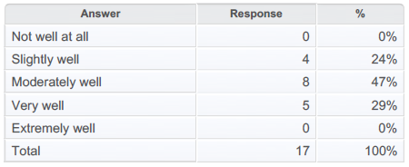
Learner Feedback Survey Results
Q4. How well did the group presentations of the findings from the Breakout Room activity work?
‘Oral presentation was workable, it might
be a good idea to have a Google doc
which can be presented in the main channel’
‘People without microphones could not
participate in the presentations’
‘Visual aids to support ideas could be improved’
‘The MS Teams Whiteboard app was difficult to
read and would not allow typing of text or ability
to add in photos from outside sources’

Slide 10
Conclusion
Overall, I was very satisfied with the Breakout Rooms functionality within MS Teams, and improvements have been made since lockdown, such as the creation of Private channels for groups (for documents, chats, easy access etc.)
The Research Survey results indicated a good level of satisfaction among the learners with the Breakout Room functionality.
The feedback was mainly positive, with some great suggestions for what could be improved from a learner’s perspective.
Preparation is key! MS Teams groups have to be set up in advance of the session, unlike other platforms. Group activities need to be uploaded in advance to ensure learners can read and understand the activity in advance.
Less Computer literate learners may struggle with the concept at first. It is a good idea to talk the learners through the process of how to join a Group session and how to return to the Main session, which unlike some other platforms, is a manual process on MS Teams.
It is possible to record the sessions in each Breakout Room, this wasn’t something that I explored, but the presentations in the Main session were recorded so that learners could view the outcomes of the activities.

Slide 11
References
The below links provide some useful information around issues with on-line learning and how Breakout Rooms can be utilised to help overcome them:
https://elearningindustry.com/5-common-problems-faced-by-students-in-elearning-overcome
https://www.luminary.com/blog/using-zoom-breakout-rooms-for-training-and-workshops

